Slide 1

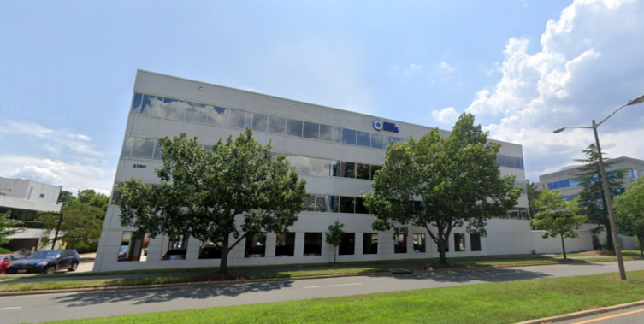


Active Directory Auditing for
CMMC Compliance
(Applied Research Associates, Inc.)
‹#›
The Alexandria branch of the ARA
CHRISTOPHER KYRIACOU | DAVID FULLER | JAMIE SUTTON | NATHAN CHONG | SAFEEULLAH GHAFOORI
Alpha Team 4 04/28/21 IT 493-004
Notes:
Welcome everyone

Slide 2
Agenda
‹#›
Original Business Process
IT Solution
Changed Business Process
Solutions Implementable
Demonstration
Alpha Team 4 04/28/21 IT 493-004

Slide 3
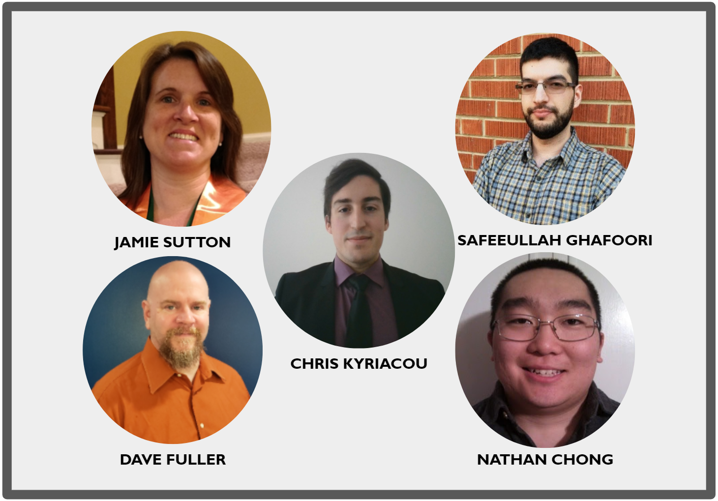
Alpha Team 4
‹#›
Alpha Team 4 04/28/21 IT 493-004

Slide 4
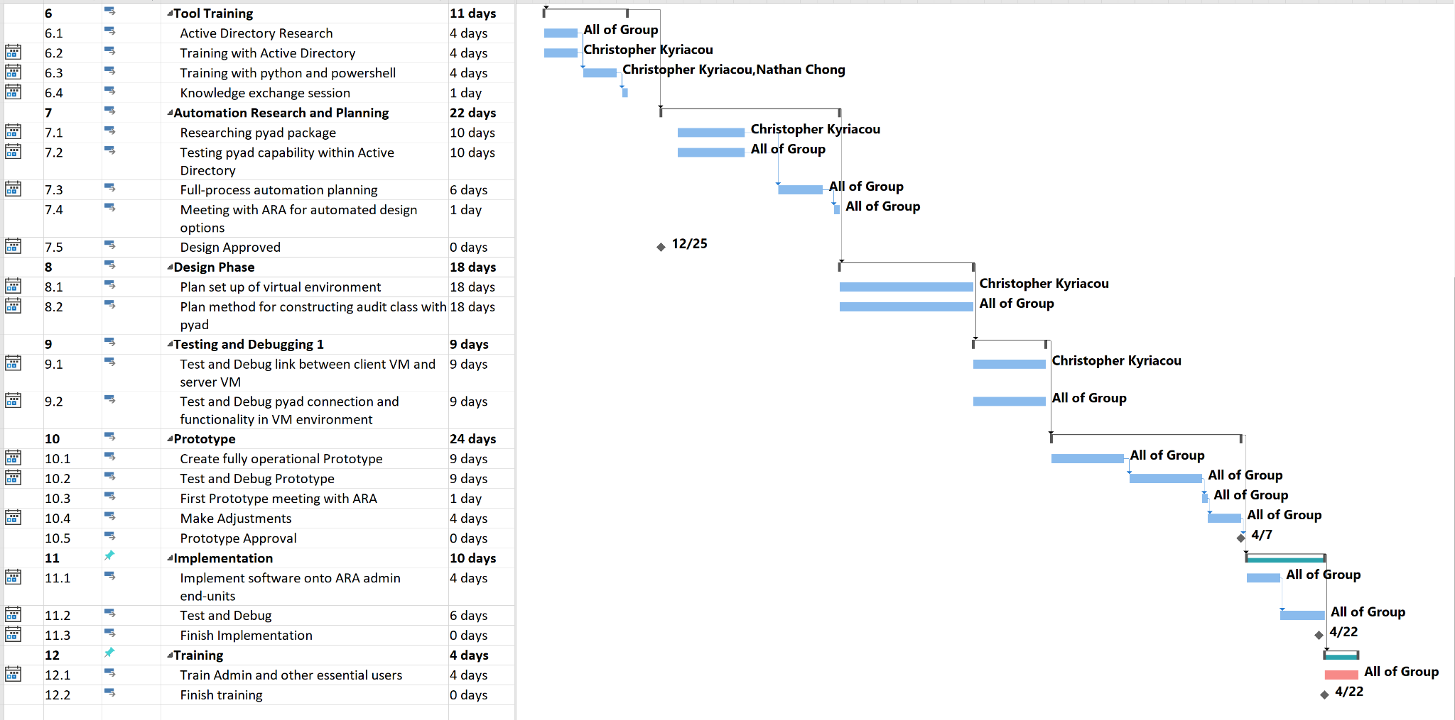
IT-493 Spring 2021 Project Schedule
‹#›
Alpha Team 4 04/28/21 IT 493-004

Slide 5
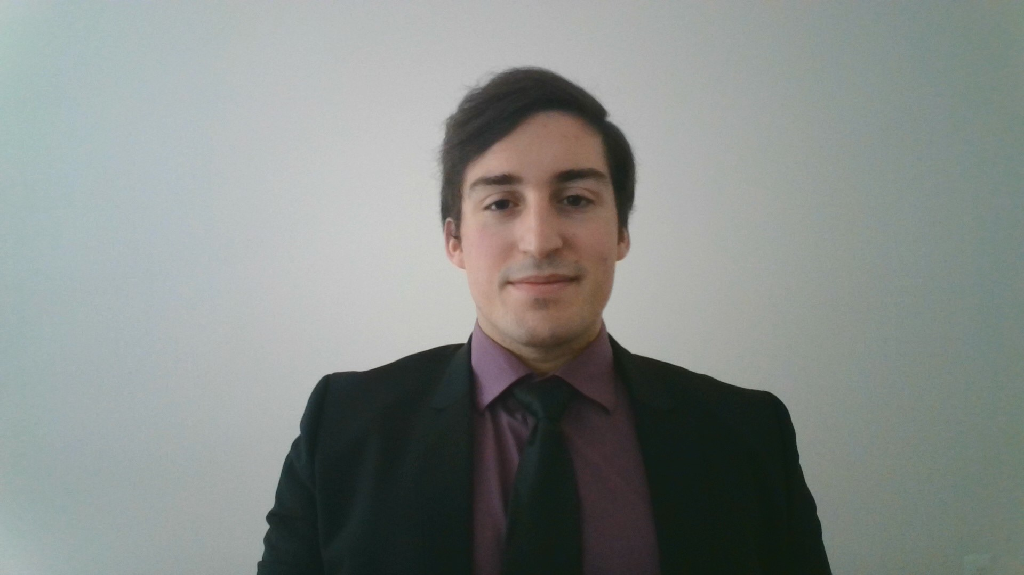
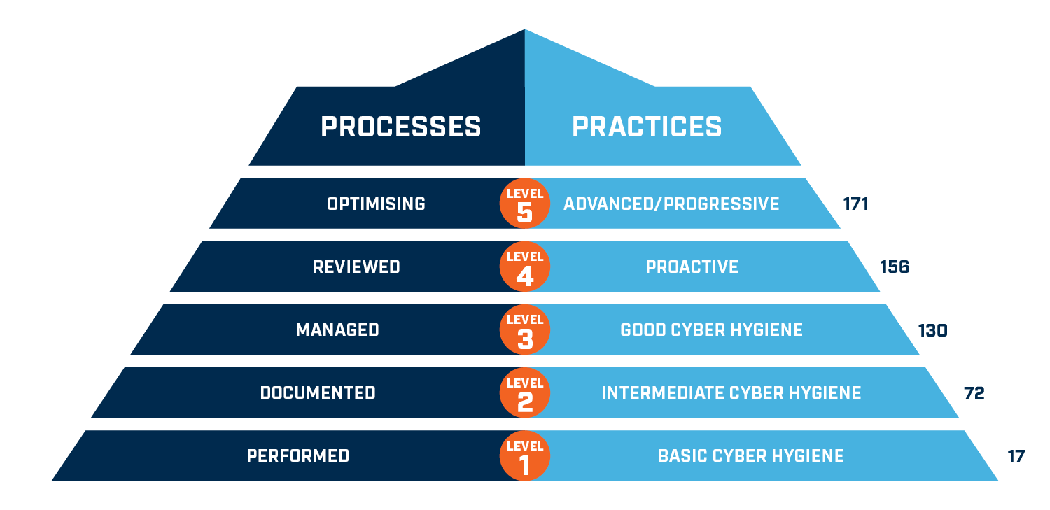
CMMC Compliance
‹#›
Cybersecurity Maturity Model Certification
Primary Goal: Safeguard controlled unclassified information (CUI) across the DoD supply chain.
CUI: Any information or data created or possessed by the government or another entity on the government’s behalf.
Levels:
1. Addressing FAR 52.204-21 cybersecurity principles.
2. Build on CMMC Level 1 and addresses a little over half on NIST 800-171 controls.
3. Build on CMMC Level 2 and addresses all NIST 800-171 controls.
4 & 5. Build off CMMC Level 3 and include controls from a range of frameworks:
CERT RMM v1.2, NIST SP 800-53, NIST SP 800-172, ISO 27002, CIS CSC 7.1, Unattributed CMMC references
Alpha Team 4 04/28/21 IT 493-004

Slide 6

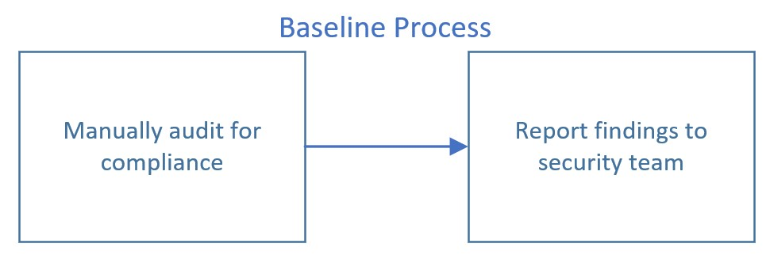
Original Business Process
‹#›
Original Process Workflow
Quantification
Auditing for: CMMC Level 2 Compliance
Time required to conduct manual audit: 10 to 30 hours
Frequency of audits: Monthly
Salary for IT Admin to conduct audit: $83,510 per year * 2 Admins = $167,020 per year*
ARA Chief of Security directs admin at all 13 branches to follow this business process:
‹#›
Alpha Team 4 04/28/21 IT 493-004
Notes:
I'm Nathan Chong and I'm presenting the Original Business Process.
The Original Process Workflow involved Auditing for Level 2 Compliance
A manual audit like this would be conducted Monthly
Two IT admins would be conducting the audits
The baseline process involves manually auditing for vulnerabilities and reporting the findings.

Slide 7
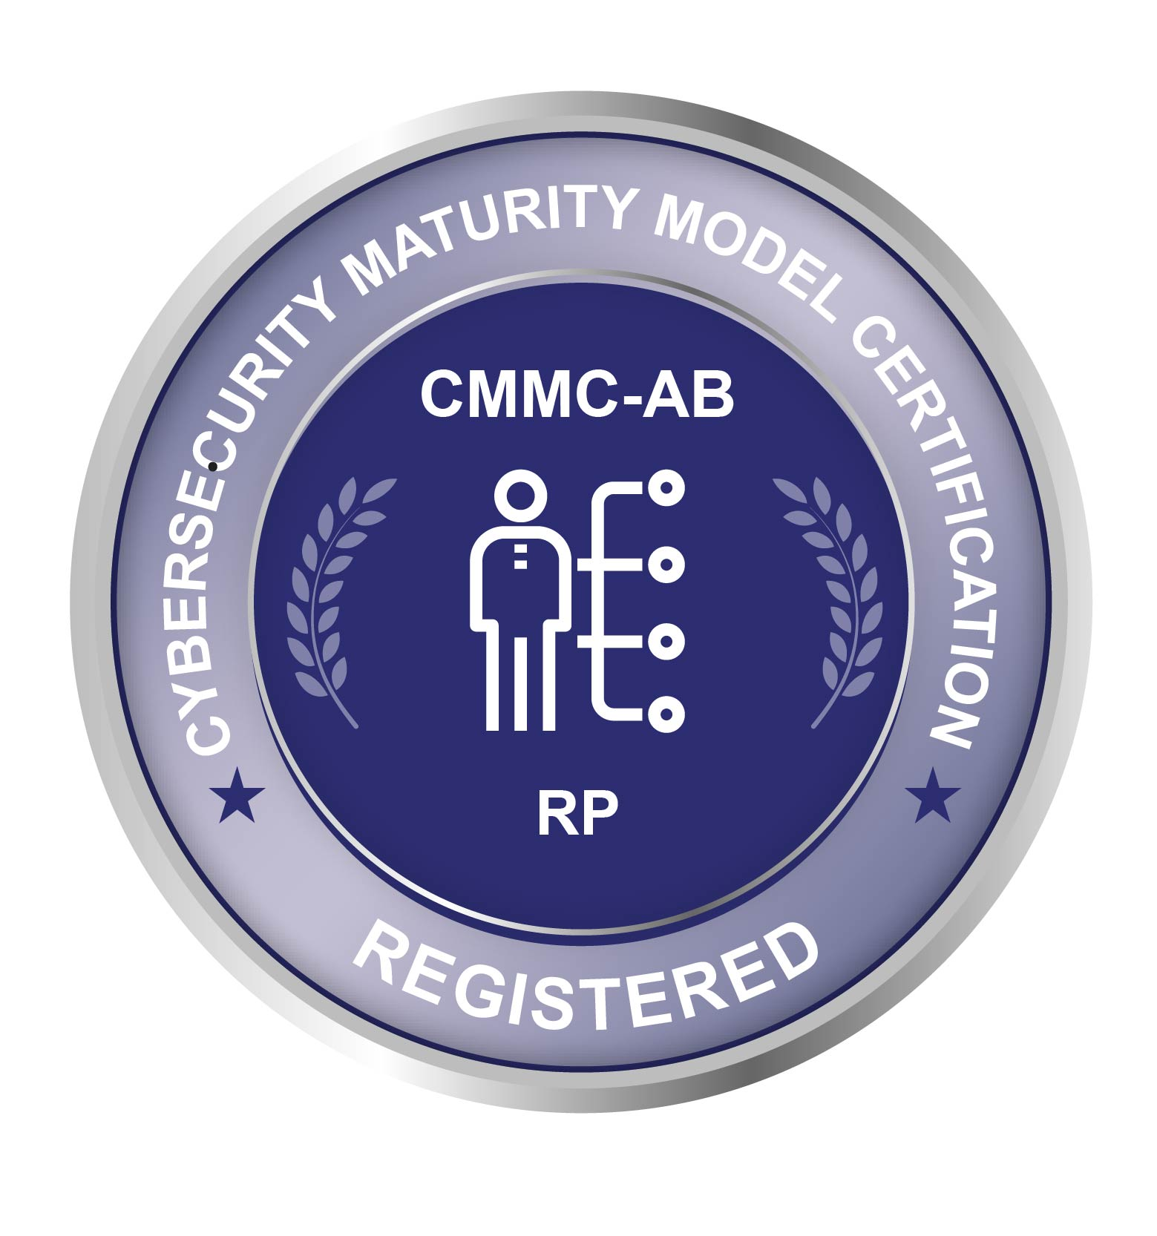


Original Business Process
‹#›
Business Case for Change for
Automated Auditing System
Important future & current contracts will require CMMC Level 3 and up
Could be required for between 10-30% of new contracts in next 2-5 years
Reduce the hours needed to audit ARA’s servers across all 13 divisions
Can take days and even weeks
Automated audits could be conducted daily
Increase confidence in information stored within Active Directory Servers
For both ARA and Gov. Clients (DoD, DHS, etc.)
‹#›
Alpha Team 4 04/28/21 IT 493-004
Notes:
Our Business Case for Change for our Automated Auditing System is that many of ARA's future contracts
will require Level 3 compliance
It would make it easier to audit ARA’s servers
and automated audits could be conducted daily
Finally it would increase confidence in information stored within ARA's servers

Slide 8



Original Business Process
‹#›
Solution Implementation Challenges
‹#›
Fully remote contact with client
No access to client AD servers or client network
Implementation must be done through client and not directly
Assumptions made about shared technical knowledge
Communication interruptions with client
Service Account Integration
‹#›
Alpha Team 4 04/28/21 IT 493-004
Notes:
Some challenges in implementing our solution include
only being able to have remote contact with client,
having No access to our client's servers or network,
the fact that our solution can only by implemented by our client and not by our team,
some false assumptions about our client's technical knowledge,
some Communication interruptions
And we had to learn about ARAs Service Accounts
And now I'd like to pass it to Chris.

Slide 9
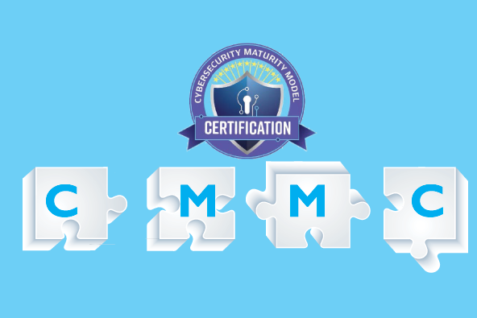
IT Solution
Auditing Active Directory for CMMC Level 3
‹#›
Main Objective: Create a tool that can audit AD servers to ensure CMMC Level 3 Compliance.
Must be open source and not rely on proprietary software
Must be automatable (Using Ansible, etc.)
Must be reliable & efficient
Must be easily maintained
Must be scalable & expandable (Eventually for Level 4 & 5)
Must meet core functionality required by the client
Alpha Team 4 04/28/21 IT 493-004

Slide 10
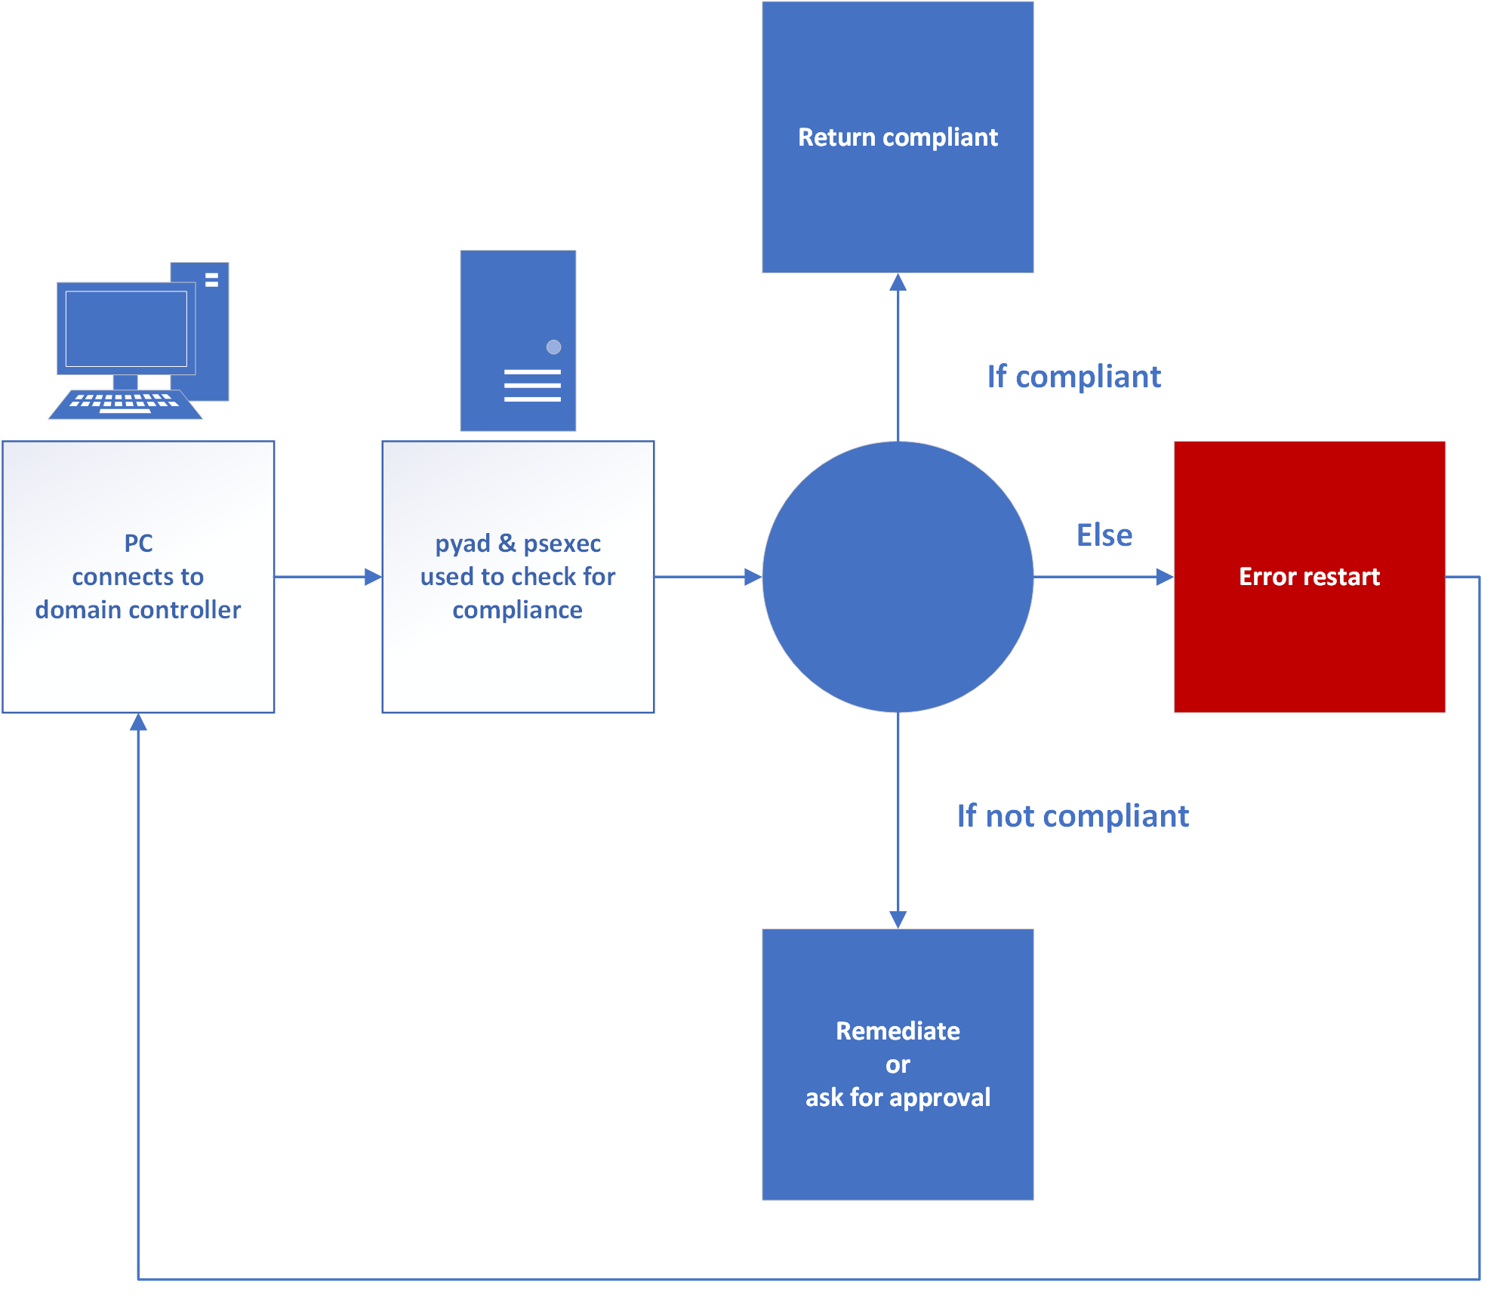
IT Solution
Desired Result
‹#›
Functions using pyad 0.6.0 & psexec to query for info
Info passed to check if
remediation is necessary
Take appropriate action based on findings or issues that occurred
Perform in minutes
Alpha Team 4 04/28/21 IT 493-004

Slide 11
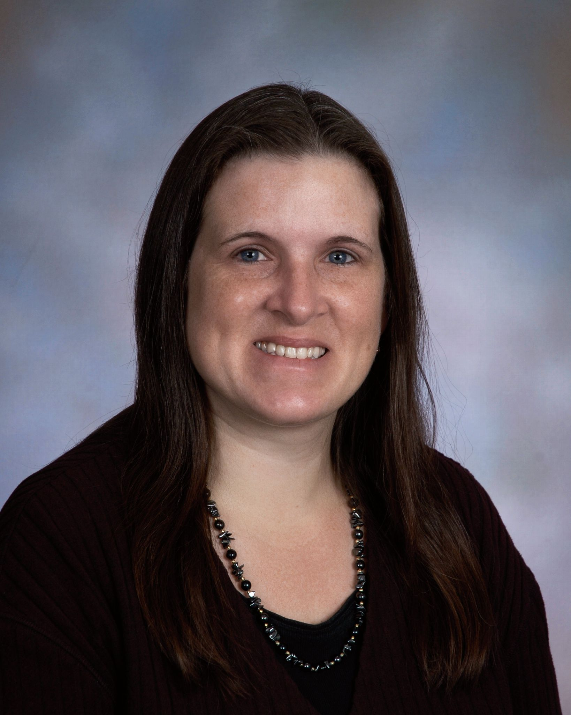

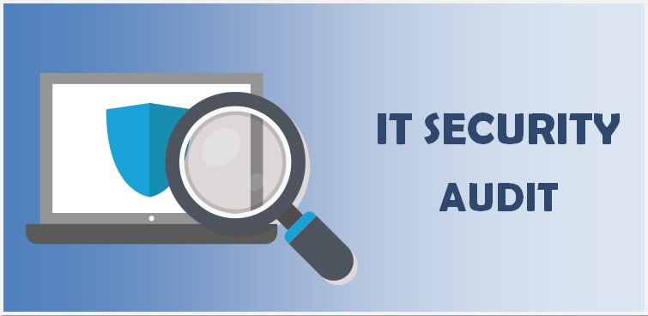
Mapping Changed Business
Process to Solution Requirements
Changed Business Process
‹#›
Changed Business Process:
Python scripts now automatically audit for compliance and generate audit report
Solution Requirements:
Create an auditing system that allows authorized security admin to audit their active directory servers for CMMC compliance and generate an audit report.
Alpha Team 4 04/28/21 IT 493-004

Slide 12
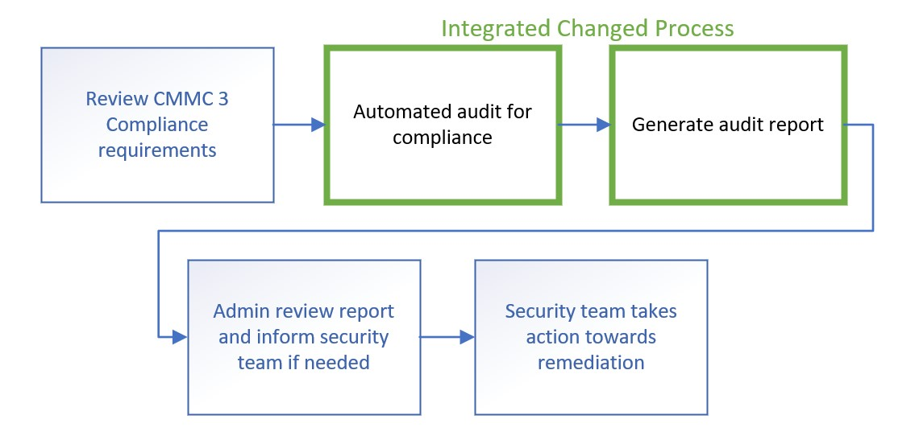
Changed Business Process
Overall Business Process
with the Integrated Changed Process
‹#›
‹#›
Alpha Team 4 04/28/21 IT 493-004

Slide 13
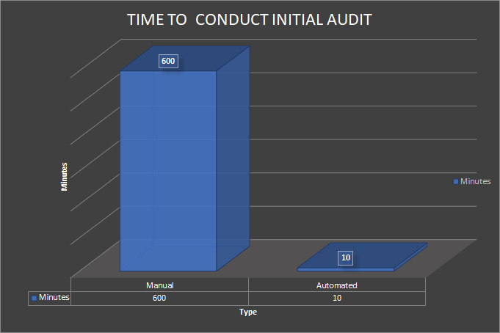
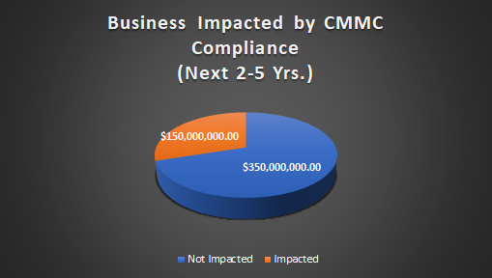
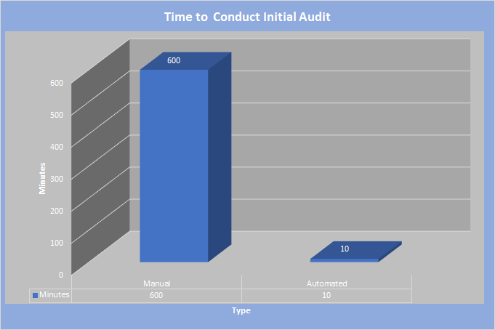
Changed Business Process
Tangible & Intangible Costs
TANGIBLE COSTS:
Labor saved: $3,060 to $12,660/yr (Per admin)
Time saved: 76.5 to 316.5 hrs/yr (Per admin)
Implementation costs: $0.00 (Open Source)
Maintenance: Client employs proper personnel
INTANGIBLE COSTS:
Increase performance efficiency: Daily audit
Refocus labor
Sustain company reputation
Achieve & sustain CMMC level 3
Alpha
Team 4-
IT 493-004
04/28/21
13
Notes:
Note to the class (but don’t write this on the slide) that the amount of security admin will likely grow as the company is growing very fast. This means that overall labor costs will increase.

Slide 14

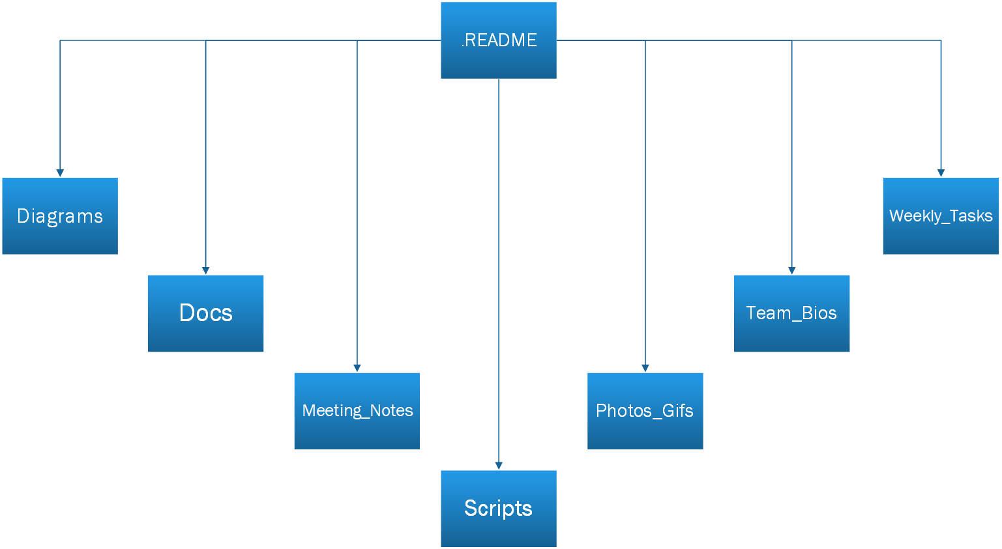
Documentation
Solution Implementable
‹#›
Alpha Team 4 04/28/21 IT 493-004
Notes:
- throughout the past few months, we've been creating documentation on a private GitHub repository
(for those unfamiliar with GitHub, its a a website and cloud-based service that helps developers store and manage their code, and track and control changes to their code)
- we've organized documentation into the sections shown in the graphic
- the most important section being the README which acts as the homepage for our repository and contains a high-level overview of what our project looks like, including a step-by-step walkthrough of our project in its entirety, from main functionality goals to achieve, to details on our solution, prototype execution GIFs and more

Slide 15
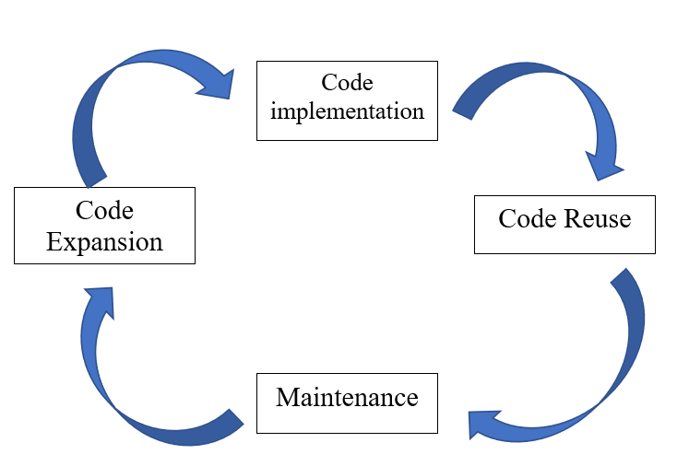
Solution Sustainment
Solution Implementable
‹#›
Our solution was designed with limited time in mind - meant for the ARA to implement the code in our script for reuse within their own systems
Aiming to give the ARA the capability to expand upon what we have achieved
Our solution is entirely open-sourced
Alpha Team 4 04/28/21 IT 493-004

Slide 16
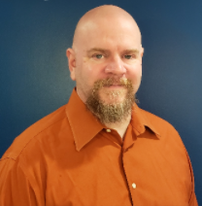
Solution Implementable
‹#›
Implementation Challenges Addressed
Challenge | Solution
Remote contact: | Regular meetings every 2 weeks & Github
No access to client server(s): | Created synonymous VM environment
Shared knowledge constraints: | Well documented instructions on processes
Service Account Integration: | Audit system can audit any service account setup
Alpha Team 4 04/28/21 IT 493-004
‹#›

Slide 17
Solution Implementable
‹#›
Project Epilogue – The Finished Product
Functional Requirement | Satisfactory/Unsatisfactory
Open Source? | Satisfactory!
Automated? | Satisfactory!
Easily Maintained? | Satisfactory!
Scaleable? | Satisfactory!
Address Core Functionalities? | Satisfactory!
Alpha Team 4 04/28/21 IT 493-004
‹#›

Slide 18

‹#›
Demonstration
Alpha Team 4 04/28/21 IT 493-004

Slide 19


Special thanks to:
Dr. Kenneth Ingham
- Corporate Senior Security Engineer (ARA)
Thank you!
Questions?
‹#›
Alpha Team 4 04/28/21 IT 493-004

